Slide 1
Things I would like to change in my country

Slide 2
Why change is necessary
India is a land of diverse cultures, rich history, and vibrant communities. However, like any nation, we face challenges that call for collective action and thoughtful transformation. This presentation is not just a reflection of my personal aspirations but an invitation to join hands in creating positive change for the generations to come.

Slide 3

Education : A Foundation for change

Slide 4
Updated Curriculum
Regularly update the curriculum to include modern knowledge and technology
Interactive Learning
Promote interactive learning where students actively participate and engage in discussions.
Teacher Training
Provide ongoing professional development to teachers to keep them updated.
Assessment Reform
Use variety of methods including project work, presentation and practical demonstrations.

Slide 5

Healthcare for All

Slide 6
Universal Access
Ensure everyone has access to basic healthcare services.
Preventive care
Prioritize preventive measures to reduce occurrence of diseases.
Mental Health Support
Integrate mental health services into the health care system.
Affordable medicines
Make necessary medications more affordable.

Slide 7
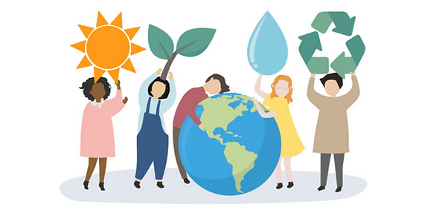
Sustainable Practice for a Greener Future

Slide 8
Energy conservation
Use energy efficient appliances and practice energy – saving habits
Tree Plantation
Participate in or support tree plantation initiatives.
Waste Reduction
Minimize single use items, adopt a zero-lifestyle.
Water Conservation
Conserve water in daily activities
Resuse
Reduce
Recylce

Slide 9

Empowering the Economy

Slide 10
Supporting small businesses
Create the right environment for small businesses to grow.
Access to financial services
Ensure everyone has access to banking and financial services.
Investing in research and development
Fosters innovation, leading to new products and industries that drive economic growth.
Infrastructure Development
Invest in infrastructure like road, bridges and technology.

Slide 11
Conclusion
The vision for change in india is not just a dream-it’s a call to action. As we’ve discussed key areas-from education to healthcare and etc, remember that each one of us holds the power to contribute to the collective progress. Let’s unite, work towards a brighter future and, turn aspirations into reality.

Slide 12
Thank You

